Slide 1
Unit2: Finite Automata and Lexical Analysis
Finite-state machine

Slide 2
Finite-state machine (FSM)
Aka finite state automaton (automata), or state machine
Model of behavior composed of a finite number of states, transitions between those states, and actions.
Similar to a "flow graph" where we can inspect the way in which the logic runs when certain conditions are met.
Abstract model of a machine with a primitive (sometimes read-only) internal memory.

Slide 3
Finite-state machine (FSM)
Initial state: state when a machine starts to execute.
Current state: is determined by past states.
Transition: state change.
Action: description of an activity that is to be performed at a given moment.
Final state: no more input processing will be performed.

Slide 4
Real world examples
Subway entrance turnstile.
Traffic light.
A safe.
Vending machine.
Heating system.
Automated subway system.
Self-driving car system.
Elevator.

Slide 5
Subway entrance turnstile
States:
locked
unlocked
Transitions:
Inserting a coin in the slot will unlock the turnstile
Pushing the arm of the turnstile will let the costumer pass and lock the turnstile

Slide 6
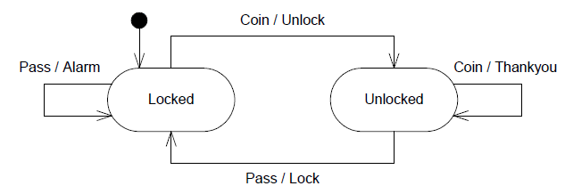
Subway entrance turnstile

Slide 7
Programming examples
Finite state machine is used to recognize patterns.
Finite automata machine takes the string of symbol as input and changes its state accordingly.
In the input, when a desired symbol is found then the transition occurs.

Slide 8
Programming examples
While transition, the automata can either move to the next state or stay in the same state.
FA has two states:
Accept state
Reject state.
When the input string is successfully processed and the automata reached its final state then it will accept.

Slide 9
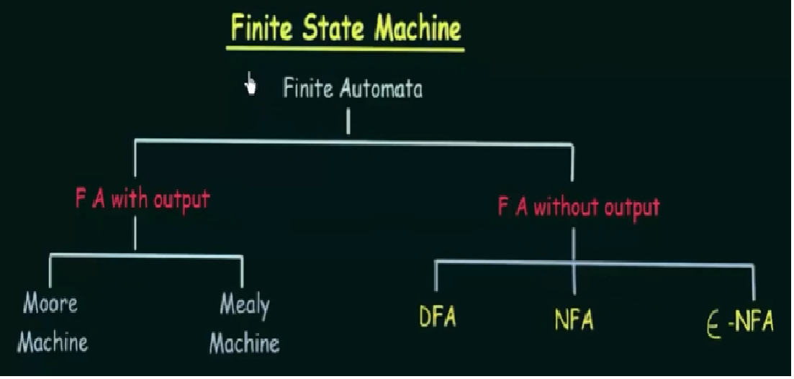
Types of FA

Slide 10
Moore Machine
Outputs are independent of the inputs
Outputs are produced from within the state of the state machine

Slide 11
Mealy Machine:
Outputs can be determined by the present state alone, or by the present state and the present inputs
Outputs are produced as the machine makes a transition from one state to another
Any Moore machine can be turned into a Mealy machine (and vice versa)

Slide 12
DFA
For each pair of state and input symbol there is one and only one transition to a next state.
recognize the set of regular languages and no other languages.

Slide 13
DFA
When the last input symbol has been received it will either accept or reject the string
Fixed number of states and we can only be in one state at a time.
Machine will be in a state, upon receipt of a certain symbol will go to a known state.

Slide 14
Finite automata
5 Tuple: (Q,Σ,δ,q₀,F)
Q: finite set of states ∑: finite set of input symbol q0: initial state F: final state (a set of accept states) δ: Transition function
Transition function can be define as
δ: Q x ∑ →Q

Slide 15
Example of DFA
Design a FA with ∑ = {0, 1} accepts those string which starts with 1 and ends with 0.

Slide 16
Example of DFA
The FA will have a start state q0 from which only the edge with input 1 will go to the next state.

Slide 17
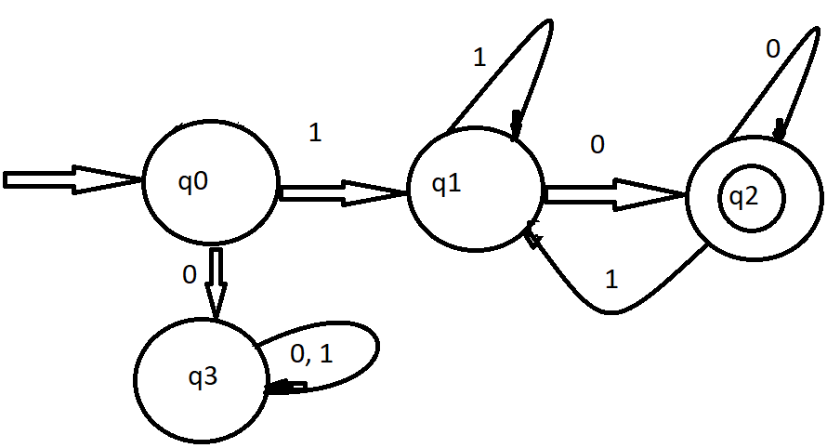
Example of DFA

Slide 18
Example of DFA
In state q1, if we read 1, we will be in state q1, but if we read 0 at state q1, we will reach to state q2 which is the final state. In state q2, if we read either 0 or 1, we will go to q2 state or q1 state respectively. Note that if the input ends with 0, it will be in the final state.

Slide 19
Example of DFA
∑ = {0, 1}
Q = {q0 , q1 , q2, q3}
q0 = q0
F = {q2}
δ =
 | input | input
 | 0 | 1
Current state | Next state | Next state
q0 | q3 | q1
q1 | q2 | q1
q2 | q2 | q1
q3 | q3 | q3

Slide 20
NFA
For each pair of state and input symbol there may be several possible next states.
Fixed number of states but we can be in multiple states at one time.
Can accept multiple destination states for the same input.

Slide 21
εNFA
Extension to NFA – a “feature” called epsilon transitions, denoted by ε, the empty string
The ε transition lets us spontaneously take a transition, without receiving an input symbol

Slide 22
εNFA
Another mechanism that allows our NFA to be in multiple states at once.
Whenever we take an ε edge, we must fork off a new “thread” for the NFA starting in the destination state.
While sometimes convenient, has no more power than a normal NFA
Just as a NFA has no more power than a DFA

